Slide 1
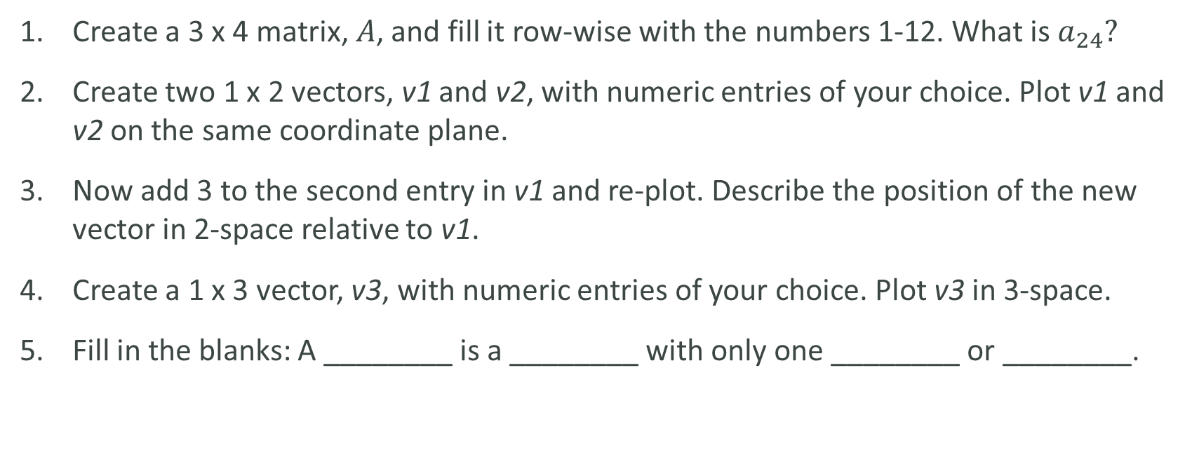
Lab
Create a 3 x 4 matrix, $A$, and fill it row-wise with the numbers 1-12. What is $a_{24}?$
Create two 1 x 2 vectors, v1 and v2, with numeric entries of your choice. Plot v1 and v2 on the same coordinate plane.
Now add 3 to the second entry in v1 and re-plot. Describe the position of the new vector in 2-space relative to v1.
Create a 1 x 3 vector, v3, with numeric entries of your choice. Plot v3 in 3-space.
Fill in the blanks: A ________ is a ________ with only one ________ or ________.

